Slide 1
Foundation of Data Science: Project Report
Rana Al-rubaye

Slide 2
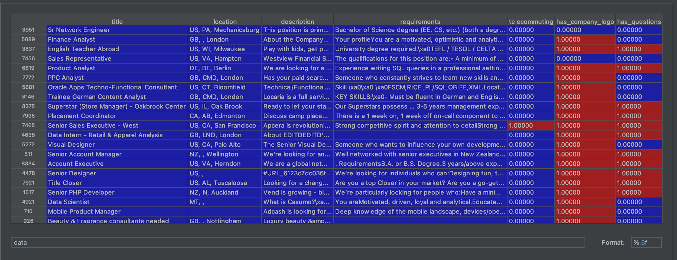
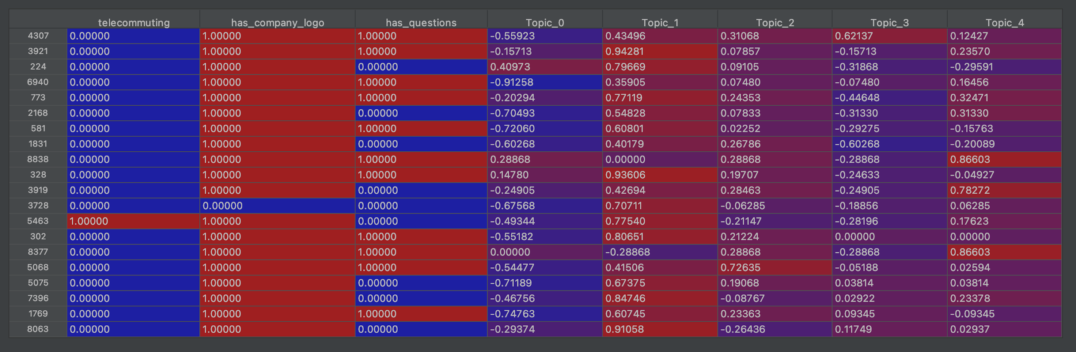
Preprocessing- Feature Hashing
Apply feature hashing on the columns (title, location, description, and requirements) to generate 4 different features

Slide 3
Preprocessing- Feature Hashing (1-2)
Split the columns that has text from columns that has number
# Take only columns that has number
X_clean = data.drop(self._pp_colums, axis=1)
self._shiftCols = X_clean.shape[1]
# Take only columns that has text
X_pre = data[self._pp_colums]
textData = []
for index, row in X_pre.iterrows():
text = "{} {} {} {}".format(row['title'],
row['location'],
row['description'],
row['requirements'])
textData.append(text)
documents = pd.DataFrame(textData, columns=['headline_text'])

Slide 4
Preprocessing- Feature Hashing (2-2)
Apply feature hashing on columns that has text. Then combine generate hashing columns with existing number columns
# create feature hashing vector for training and use it in testing
if self.vectorizer == None:
self.vectorizer = HashingVectorizer(n_features=self._numberOfTopics)
# Apply feature hashing only on columns that has text
vectors = self.vectorizer.fit_transform(documents["headline_text"])
else:
vectors = self.vectorizer.transform(documents["headline_text"])
# Add new columns for haashing the text data
for idx in range(self._numberOfTopics):
X_clean["Topic_{}".format(idx)] = np.nan
# combine hashing data with other colums that has number only
row_index = 0
for vector in vectors:
for idx in range(len(vector.data)):
X_clean.iloc[row_index, self._shiftCols + idx] = vector.data[idx]
row_index = row_index + 1

Slide 5
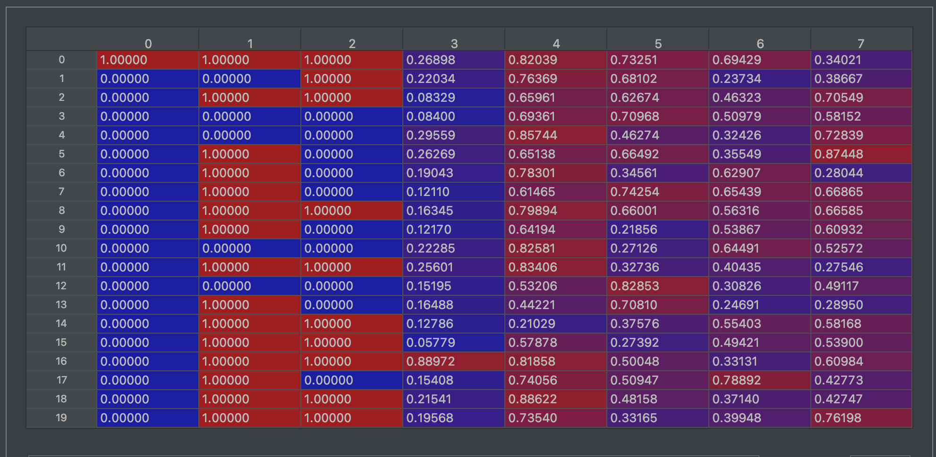
Normalize the data
Put all data in same scale using min/max scale
# normalize the data
min_max_scaler = preprocessing.MinMaxScaler()
X_norm = min_max_scaler.fit_transform(X_train_balance)

Slide 6
Data balance
Up-sample vs Down-Sample
balancing the data
0 6787
1 365
Downsampling where where we random pick samples from majority that match the minority samples
1 365
0 365
df_majority = data[data.fraudulent == 0]
df_minority = data[data.fraudulent == 1]
# Downsample majority class
df_majority_downsampled = resample(df_majority,
replace=False, # sample without replacement
n_samples=df_minority.shape[0], # to match minority class
random_state=123) # reproducible results
# Combine minority class with downsampled majority class
df_sampled = pd.concat([df_majority_downsampled, df_minority])
Up and Down sampling give same accuracy while down sampling faster since we have less samples.

Slide 7
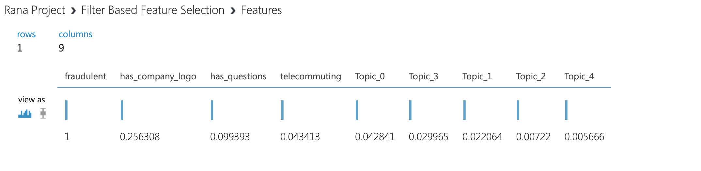
Feature selection
All features are important base on filter base section results

Slide 8
Model Training
We use stochastic gradient descent (SGD) learning. Also we notice similar results using different algorithms such as decision tree.
def fit(self, X, y):
X_train = textNLP.pre_pro_Cols(X)
[X_train_balance, y_balance] = textNLP.balanceData(X_train,y)
X_norm = min_max_scaler.fit_transform(X_train_balance)
# Create stochastic gradient descent
self.clf = SGDClassifier()
self.clf.fit(X_norm, y_balance)

Slide 9
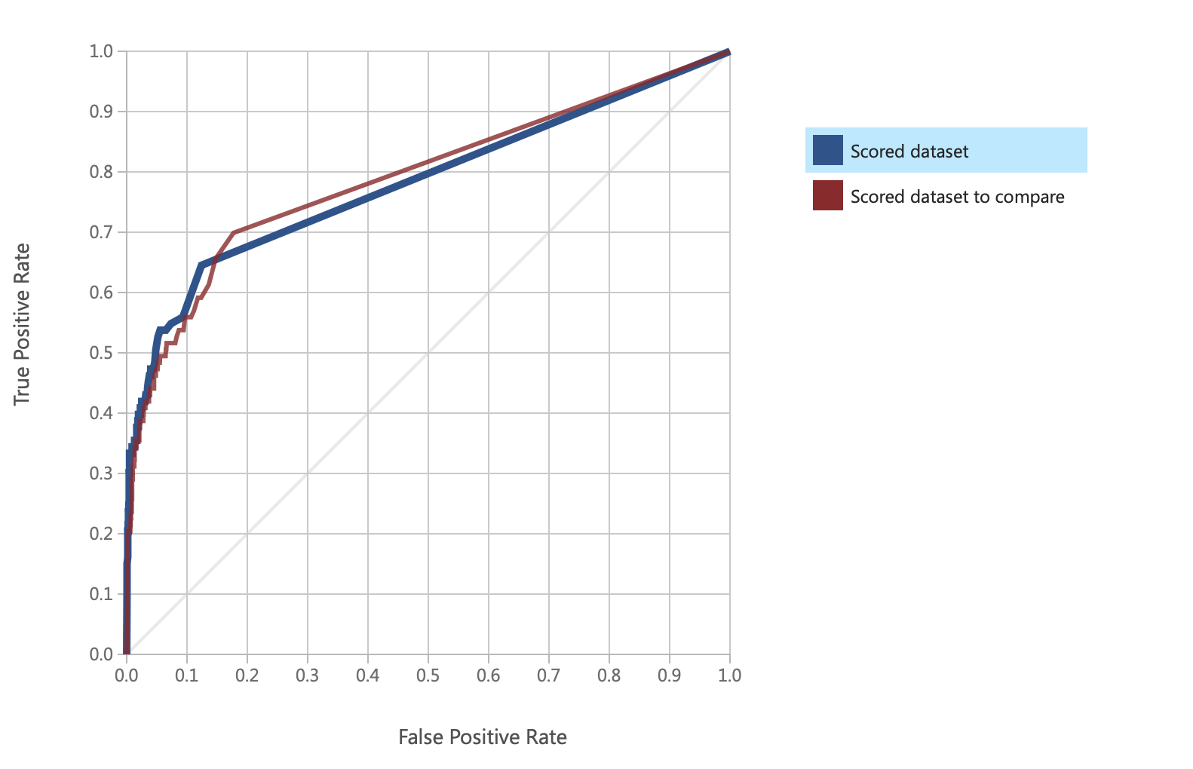
Model Selection and Tuning
Not noticeable impact

Slide 10
Prediction
def predict(self, X):
X_test = textNLP.pre_pro_Cols(X)
X_norm = min_max_scaler.fit_transform(X_test)
return self.clf.predict(X_norm)

Slide 11
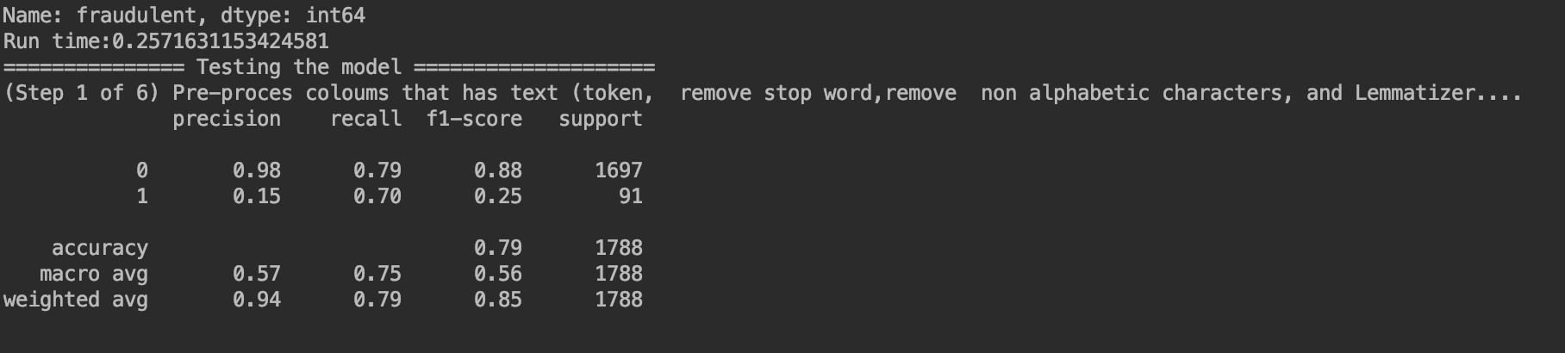
Model Evaluation

Slide 12
Questions?

